Slide 1

FLOOD MONITORING
DEPARTMENT OF COMPUTER SCIENCE AND ENGINEERING
A Comprehensive flood monitoring solution
TEAM MEMBERS:
NAVADEEP (113321104020)
DRAVID M (113321104021)
GNANESWARAN B (113321104024)
HARSHAVARDAN (113321104029)
MOHANKUMAR V S (113321104061)
TEAM NAME:
Proj_224785_Team_3

Slide 2
PROBLEM DEFINITION
Flood monitoring involves the systematic collection, analysis, and interpretation of data related to floods, with the aim of understanding and predicting flood occurrences, assessing their impact, and developing effective strategies for mitigation and response.
Data collection and Sensor Deployment
Data processing and analysis
Early Warning Systems
Modeling and Prediction
Risk Assessment and Vulnerability Mapping
Integration and Information Dissemination.

Slide 3
OBJECTIVES
The objectives of a flood monitoring project are designed to ensure effective flood detection, prediction, preparedness, response, and recovery. These objectives aim to minimize the adverse impacts of flooding on communities, infrastructure, and the environment. Here are the key objectives:
Early Warning and Preparedness
Real-time Data Collection
Risk Assessment and Vulnerability Mapping
Prediction and Modeling
Community Engagement and Education
Infrastructure Protection and Resilience
Integration with Disaster Management

Slide 4
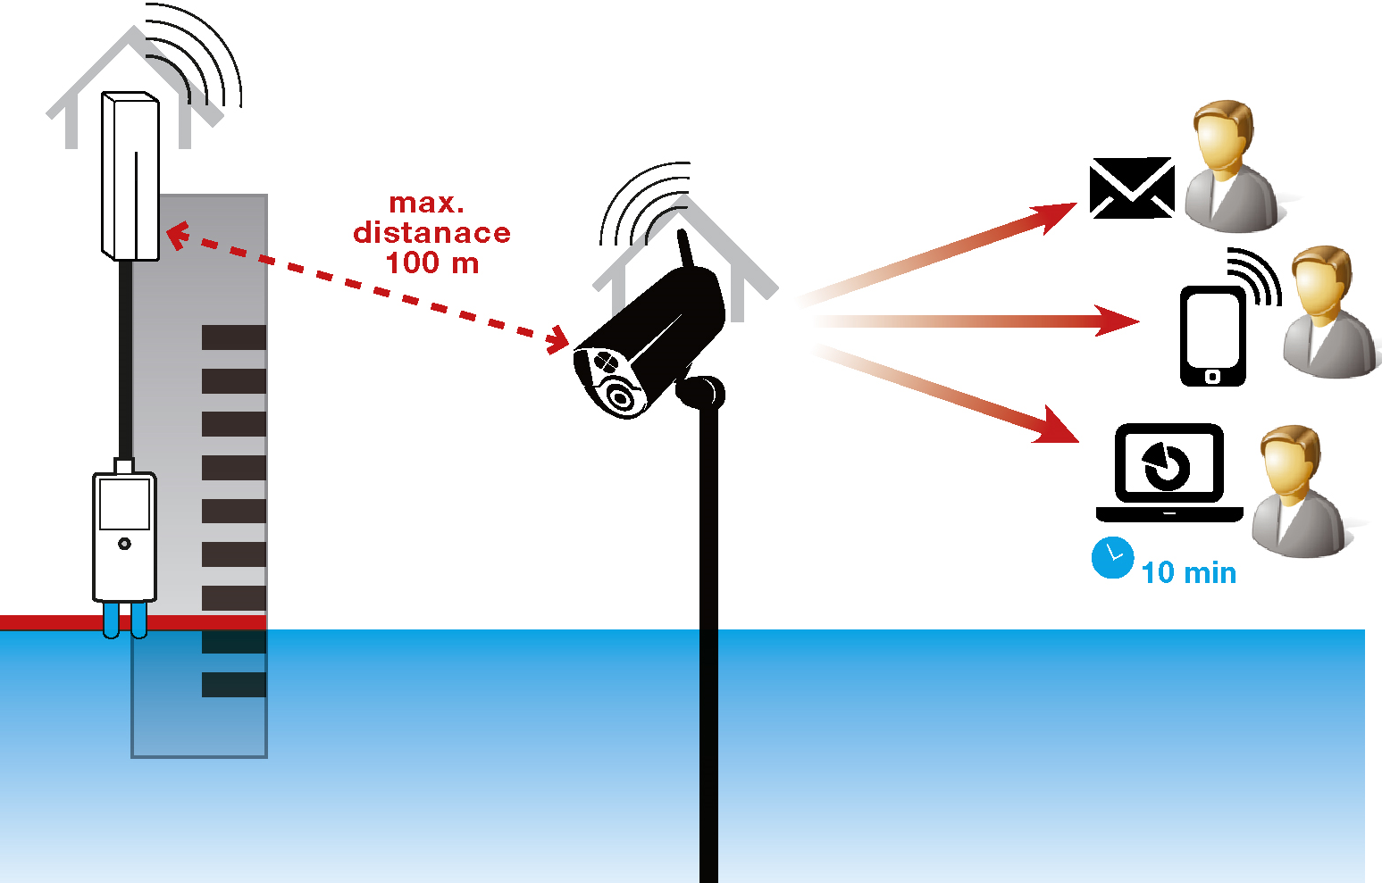
IOT SENSOR DESIGN

Slide 5
IOT SENSOR DESIGN
Designing IoT (Internet of Things) sensors for flood monitoring involves creating devices that can collect, transmit, and analyze data related to various parameters associated with flooding. These sensors play a crucial role in providing real-time information for early flood detection, prediction, and response. Here's a step-by-step guide to design IoT sensors for flood monitoring:
Identify Key Parameters to Monitor
Sensor Selection and Integration
Power Supply
Connectivity
Data Transmission Protocol
Data Processing and Analysis
Centralized Data Storage

Slide 6
Real-Time Transit Information Platform:
Creating a Real-Time Transit Information Platform for flood monitoring involves designing a system that provides timely and accurate information about the status of transportation routes during flooding events. This platform helps commuters and authorities make informed decisions related to transit safety and planning. Here are the key components and steps for developing such platform:
Data Integration and Collection
Flood Monitoring Data Integration
Weather Data Integration
Traffic and Transportation Data Integration
Real-Time Data Processing and Analysis

Slide 7
INTEGRATION APPROACH
Integration in flood monitoring involves bringing together various systems, data sources, technologies, and stakeholders to create a comprehensive and cohesive approach for monitoring and managing flood-related information. An effective integration approach in flood monitoring encompasses data integration, technology integration, stakeholder collaboration, and seamless communication. Here's a detailed approach to integration in flood monitoring:
Identify Data Sources and Types
Standardize Data Formats and Protocols
Centralized Data Repository
Data Integration and Fusion
Real-Time Data Processing

Slide 8
INTEGRATION BENEFITS
Integration in flood monitoring offers numerous benefits that contribute to the efficiency, effectiveness, and reliability of flood monitoring systems. These benefits enhance the ability to predict, respond to, and manage floods, ultimately minimizing their impact on communities and the environment. Here are the key benefits of integration in flood monitoring:
Comprehensive Data Analysis
Improved Early Warning Systems
Enhanced Decision-making
Efficient Resource Allocation
Customized Alerts and Notifications

Slide 9
THANK YOU

